Slide 1
Contextformer Hallucination Investigation
Dong Zhang
CCRS Government of Canada
November 12, 2025

Slide 2
Methods & Summary
Eliminating hallucinations through retraining:
Retrained Contextformer 6M on the greenearthnet 34TET training region for 100 epochs
Generated predictions for minicube 225 of the ood-t chopped sites with the retrained model
The hallucination on MJJ21 timestep 10 is eliminated however it does not seem to be able to predict vegetation growth as can be seen in the overlapping MJJ21, JAS21, and SON21 predictions
Identifying hallucinations:
Separated previous MJJ21 ood-t predictions into single timestep GeoTIFF files to be viewed in File Explorer
63 hallucination sites were identified in this way for the May, June, July 2021 season
For 10 MJJ hallucination sites, the overlapping JAS predictions are shown

Slide 3
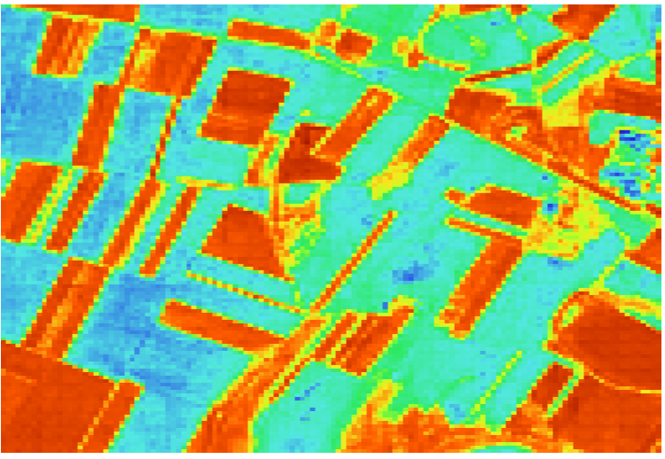
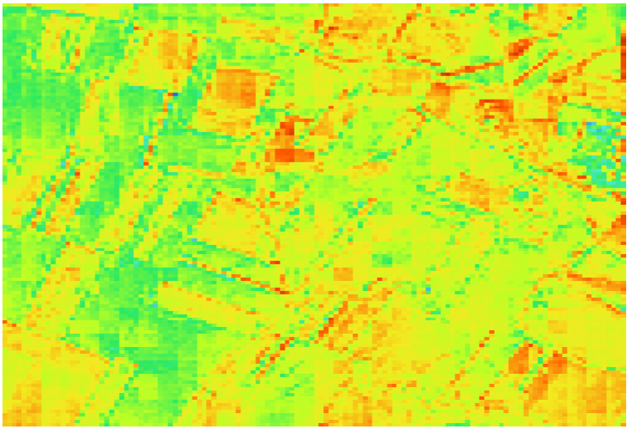
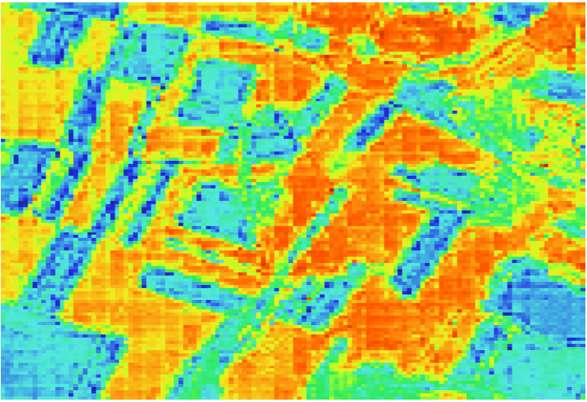
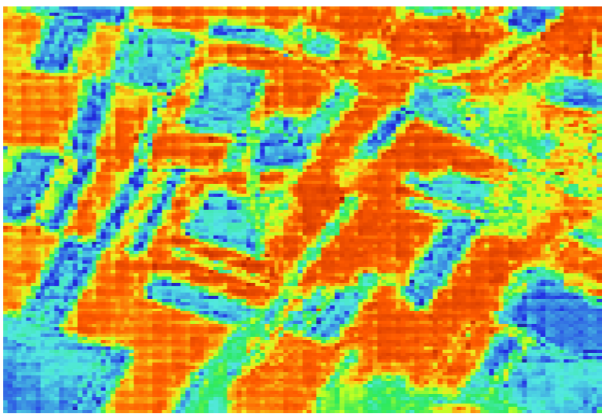
Original results (MJJ)
Timestep 5
Timestep 10
Timestep 15
Timestep 20

Slide 4
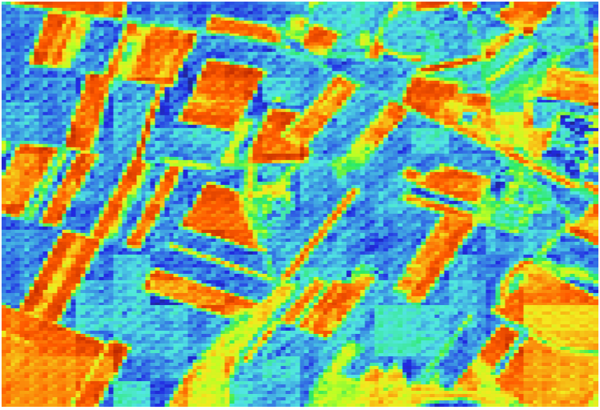
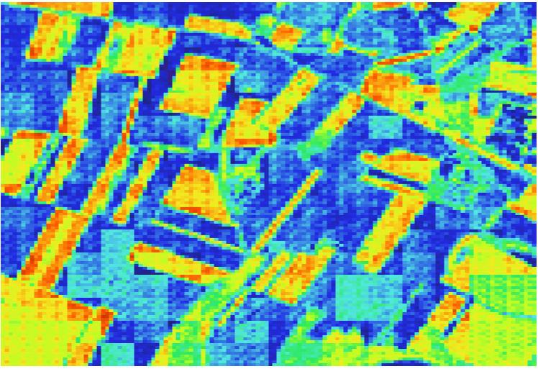
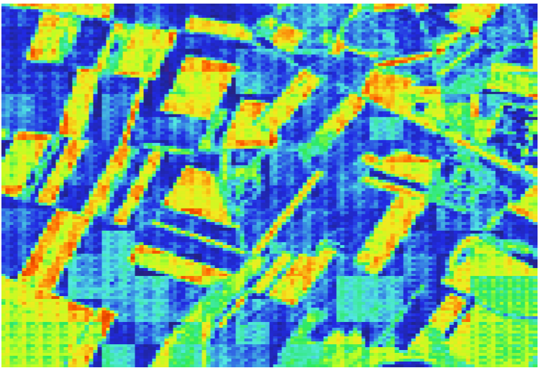
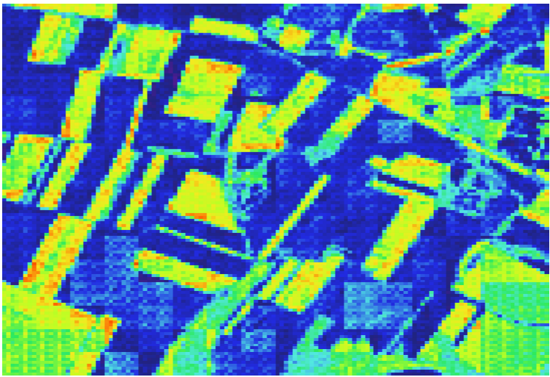
Retraining results (MJJ)
Timestep 5
Timestep 10
Timestep 15
Timestep 20

Slide 5
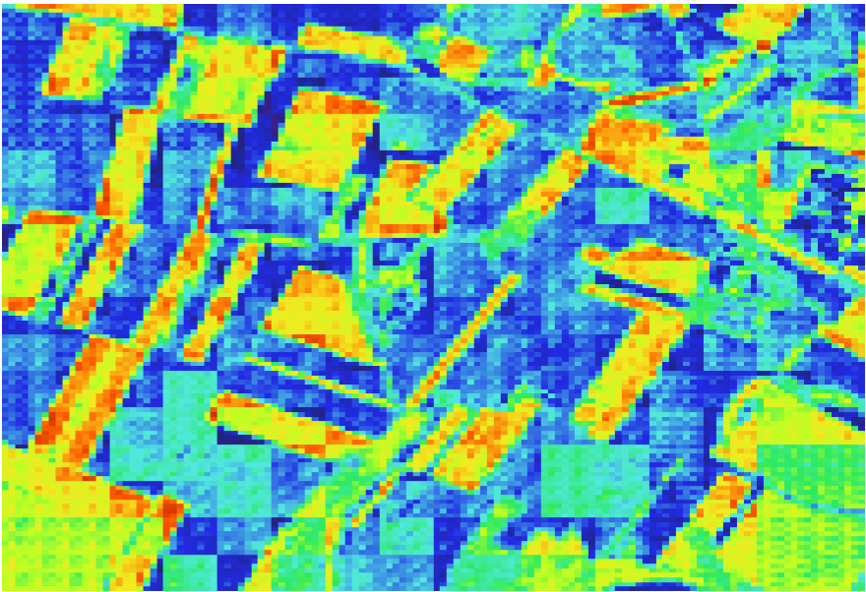
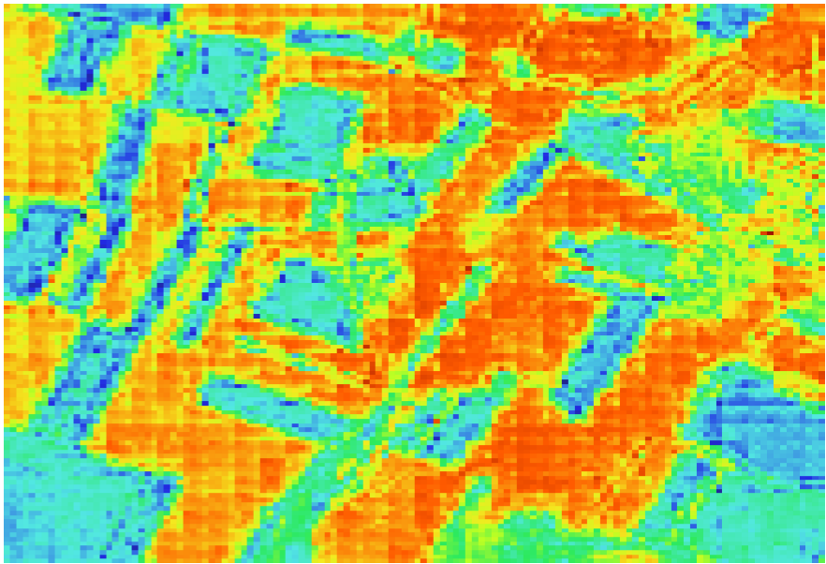
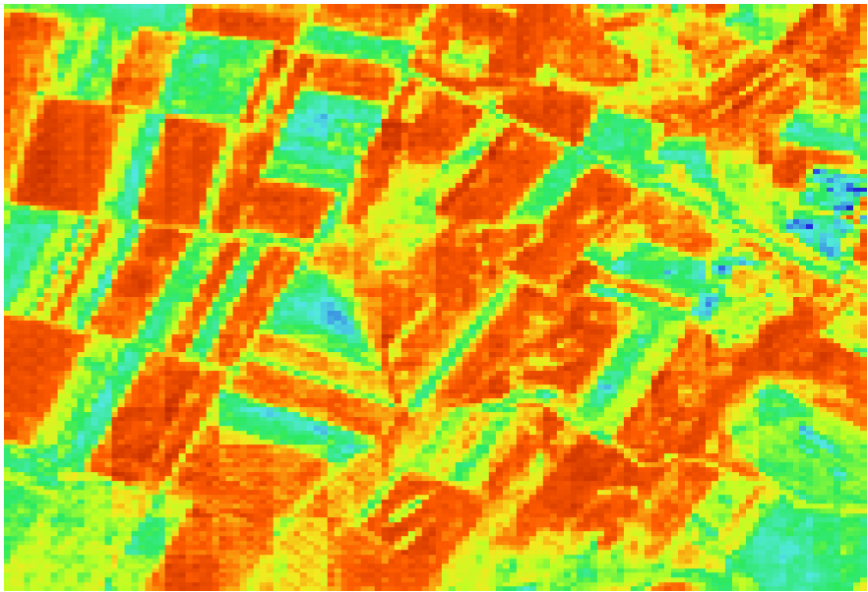
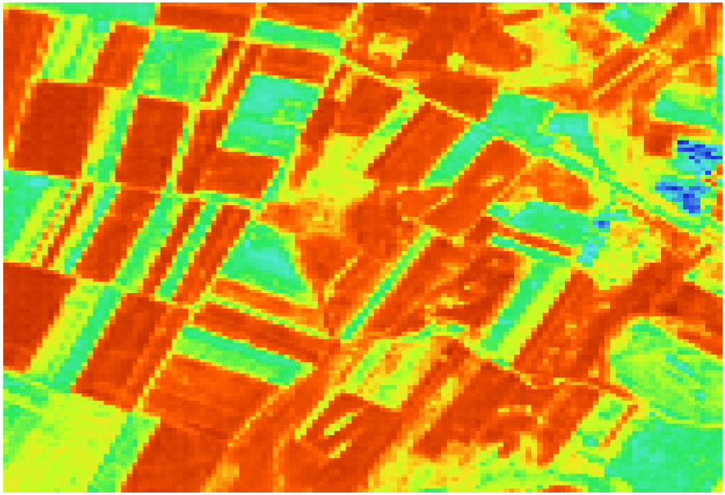
MJJ overlapping JAS
Retrained predictions
Original predictions
MJJ
Timestep 14
JAS
Timestep 1

Slide 6
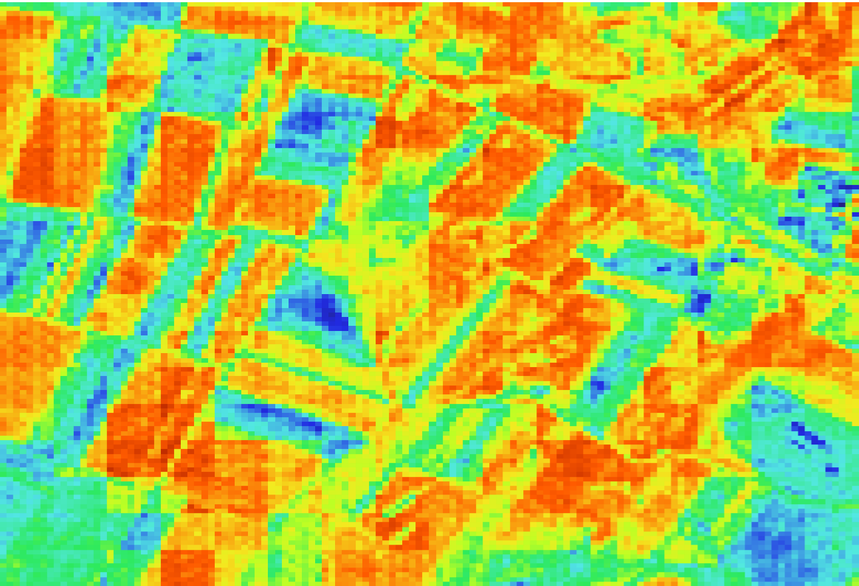
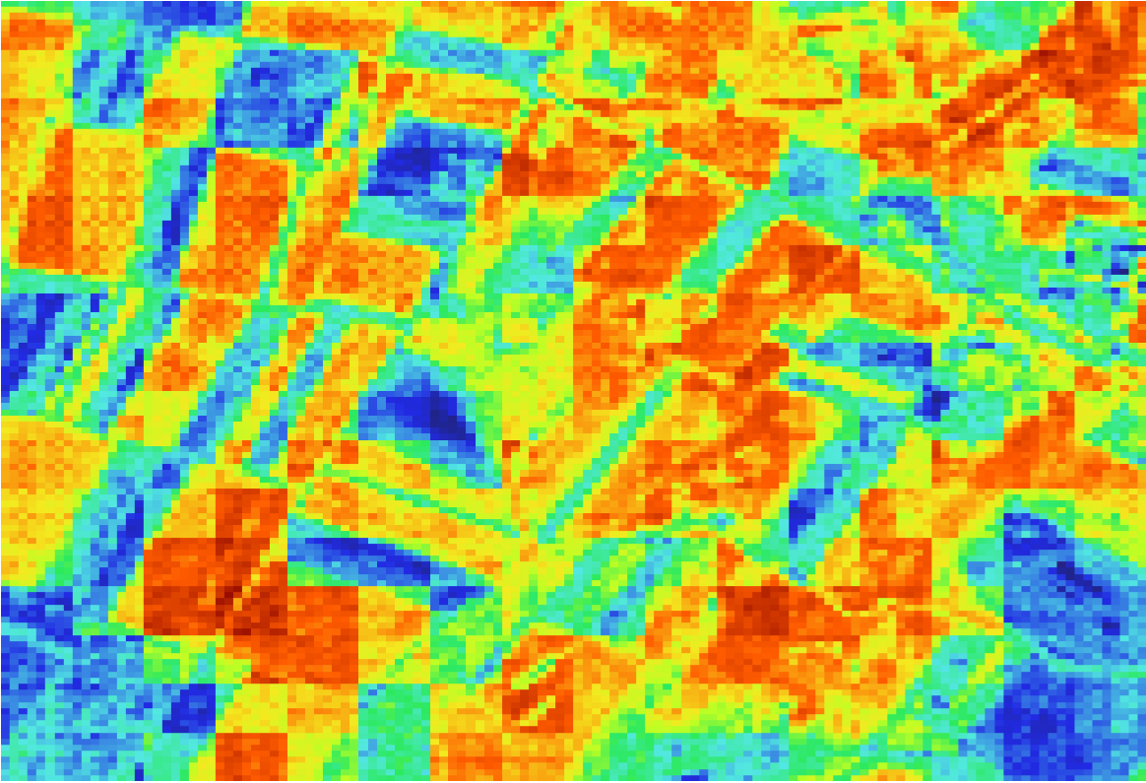
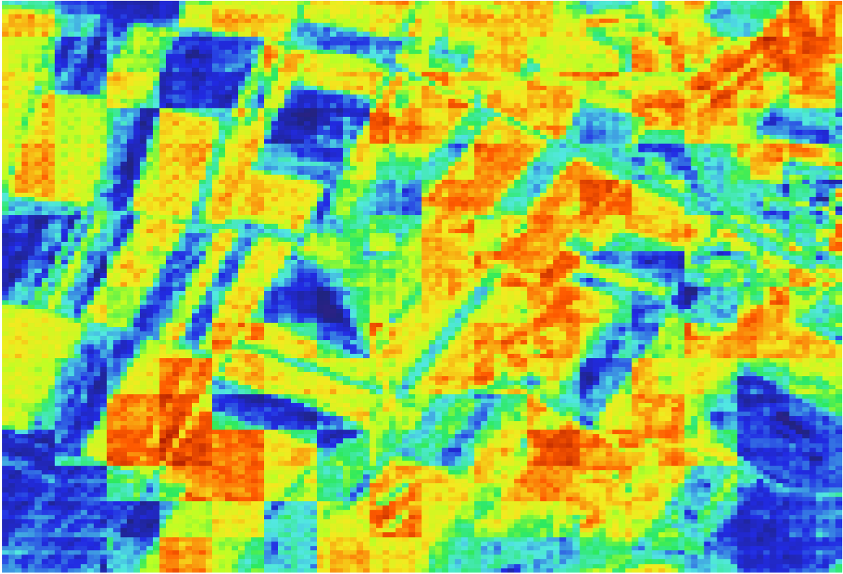
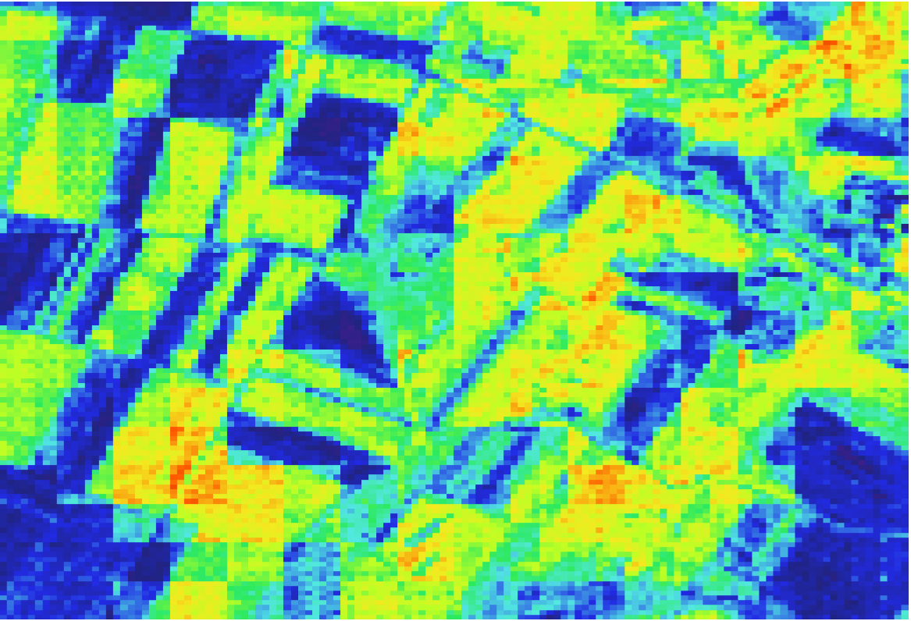
Retraining results (JAS)
Timestep 5
Timestep 10
Timestep 15
Timestep 20

Slide 7
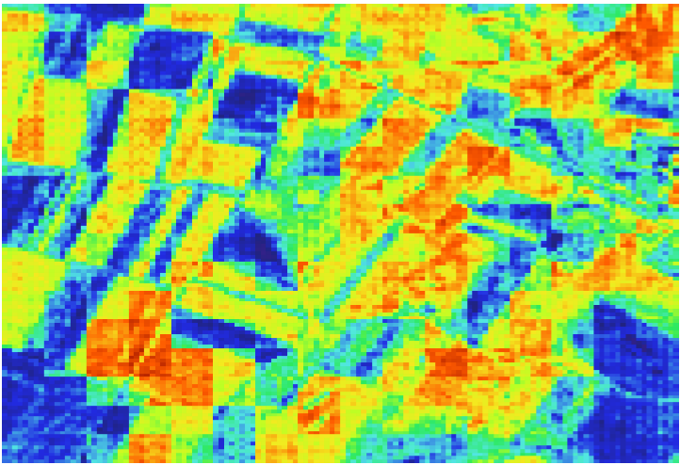
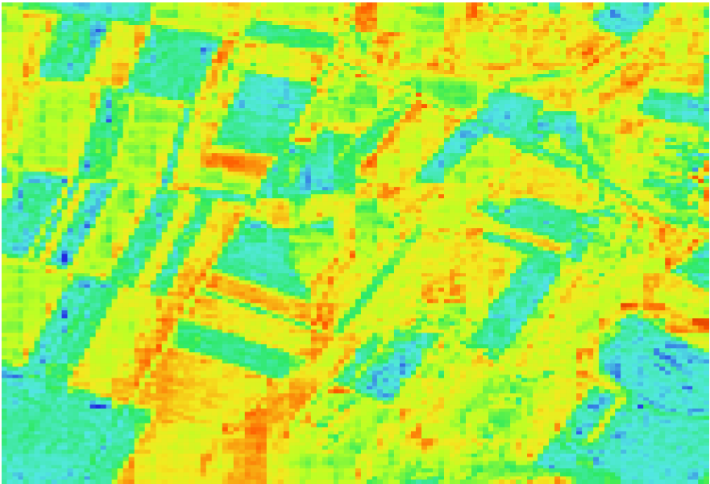
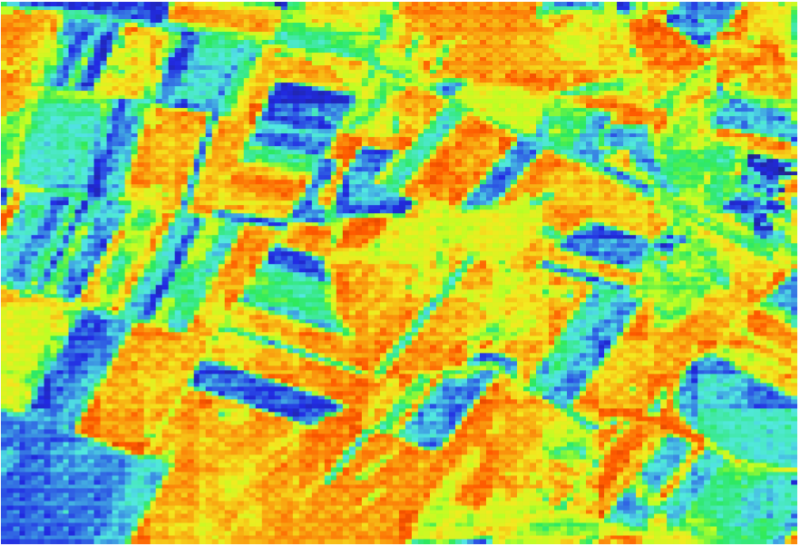
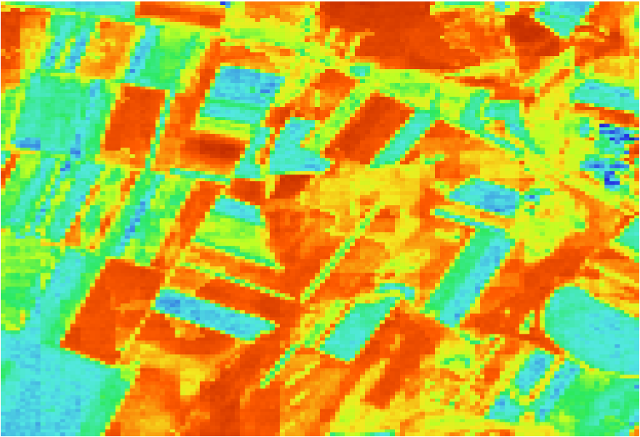
JAS overlapping SON
Retrained predictions
Original predictions
JAS
Timestep 13
SON
Timestep 1

Slide 8
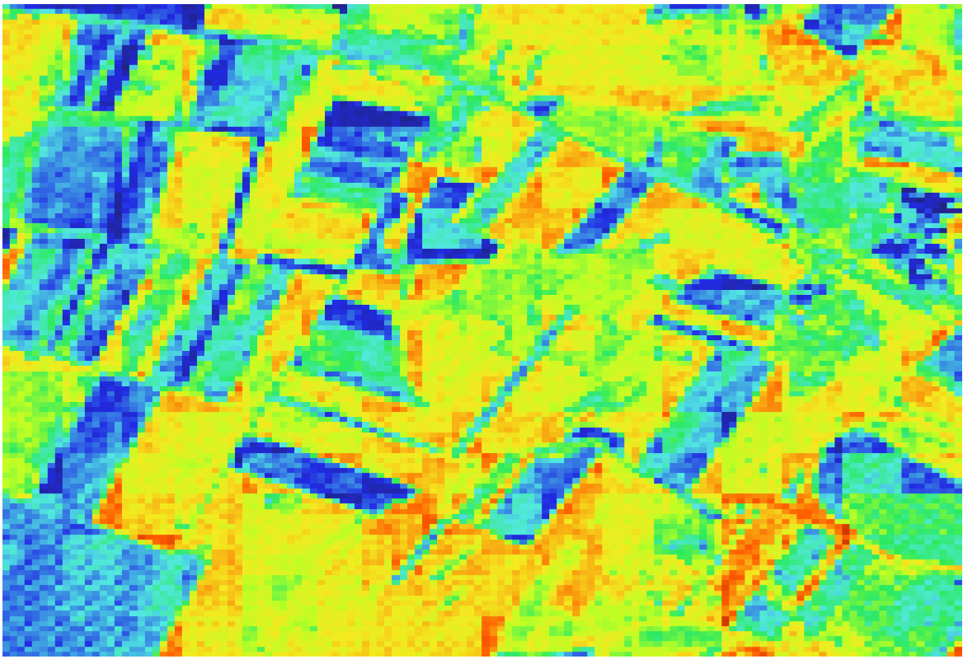
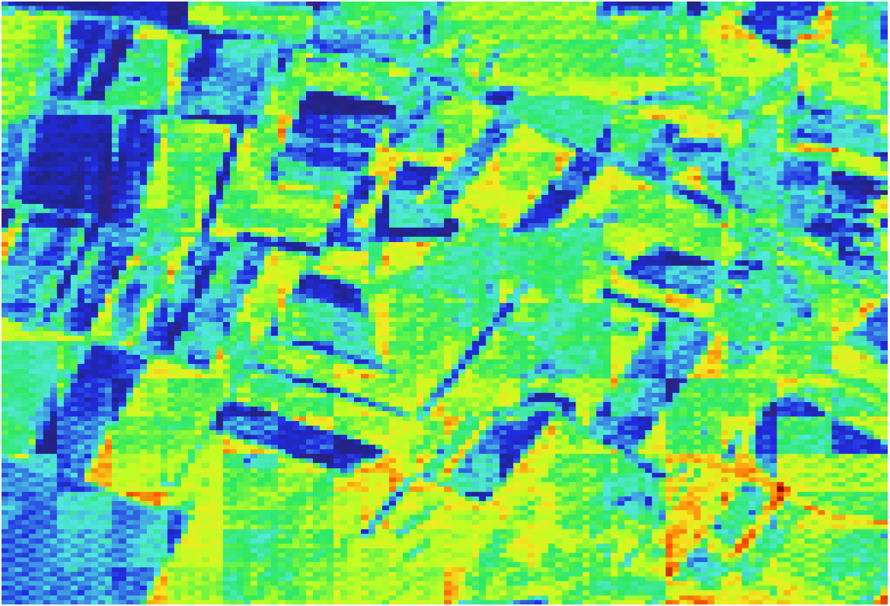
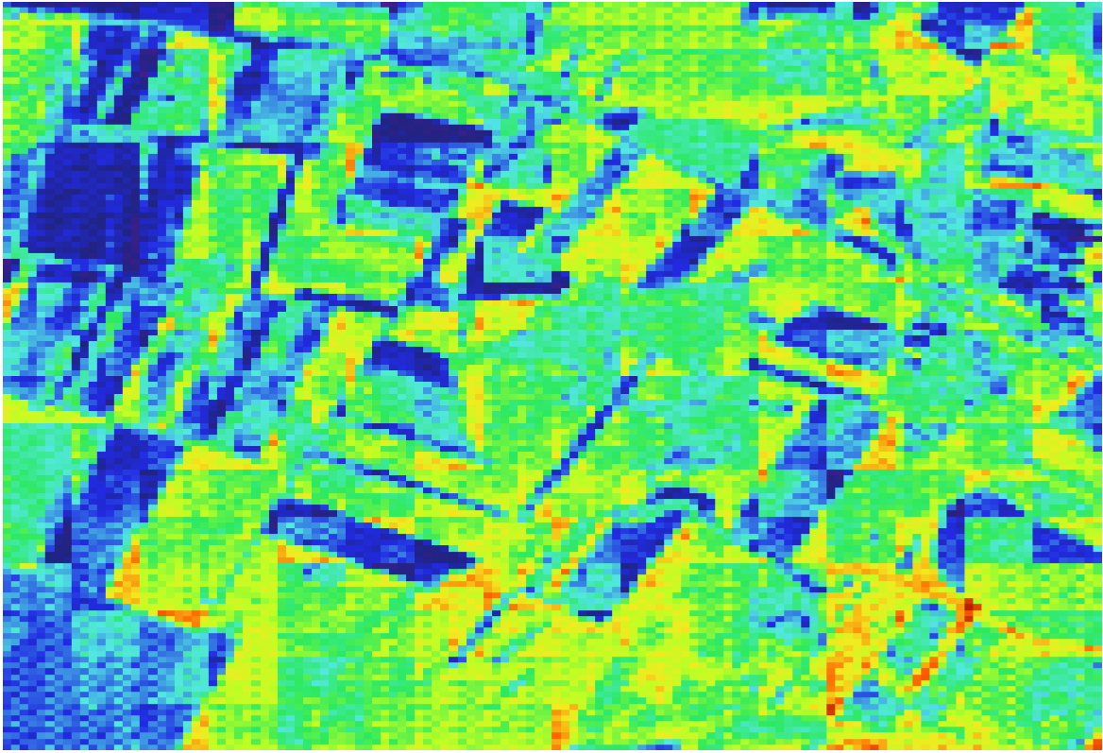
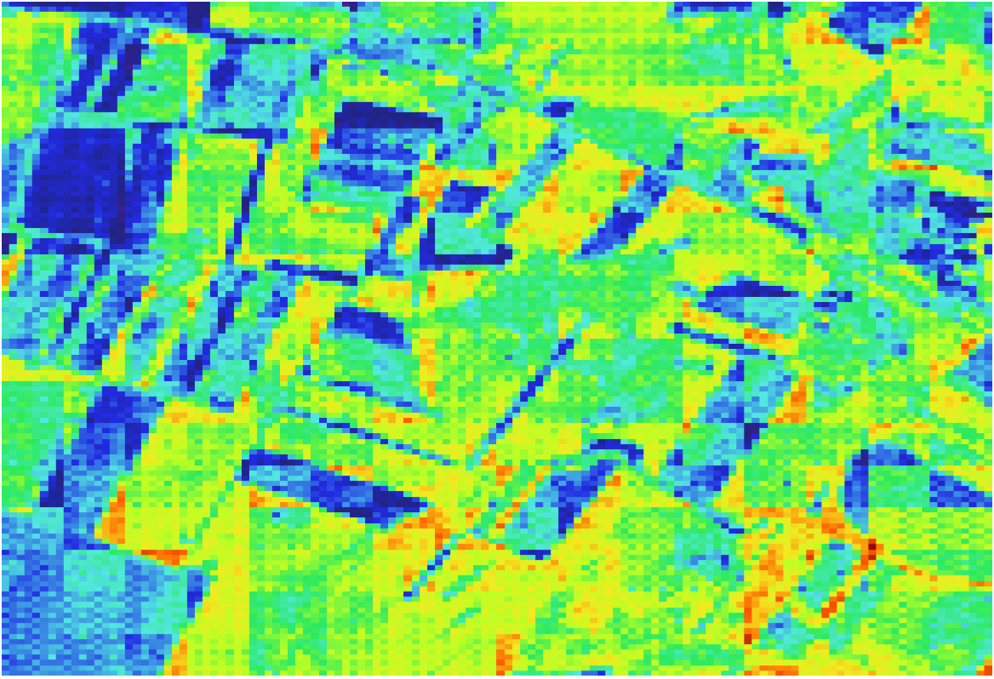
Retraining results (SON)
Timestep 5
Timestep 10
Timestep 15
Timestep 20

Slide 9
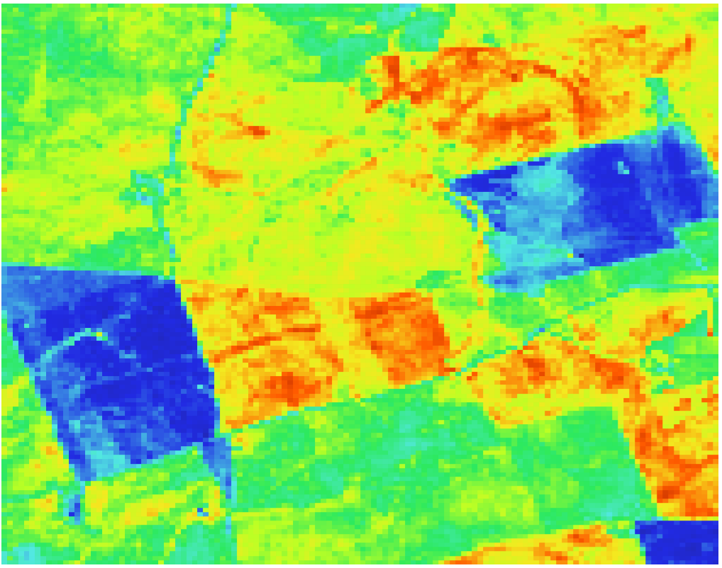
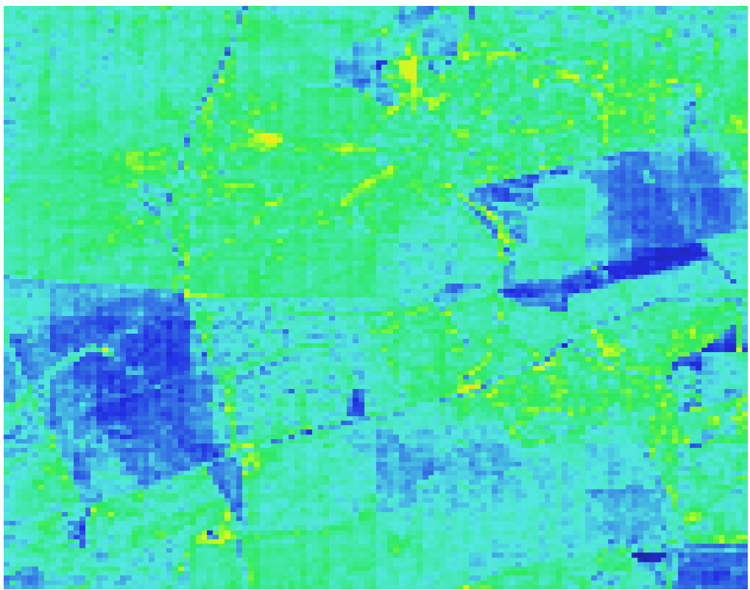
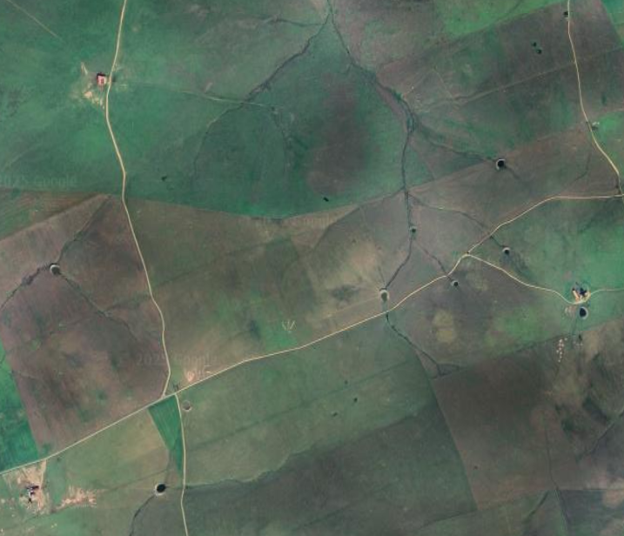
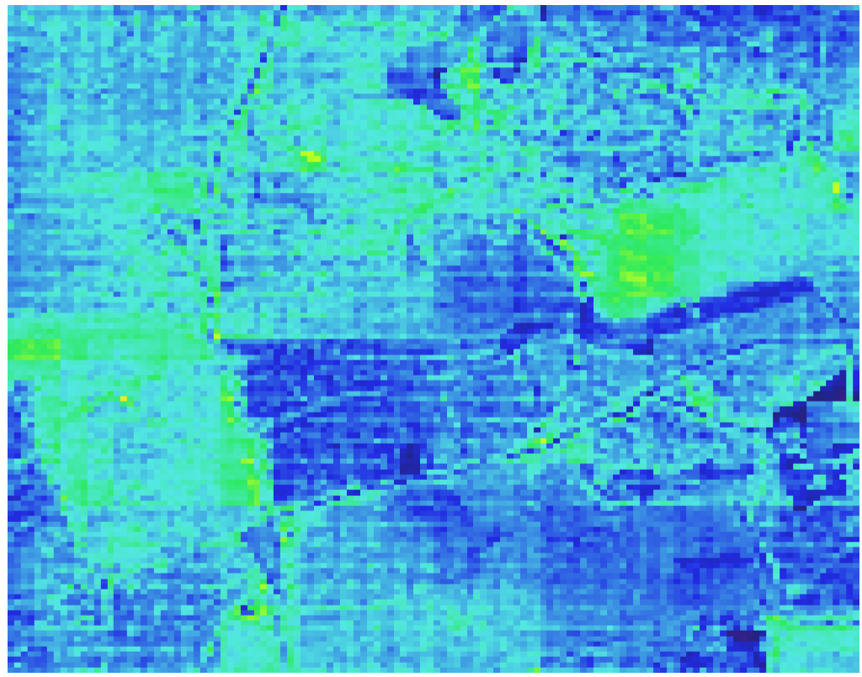
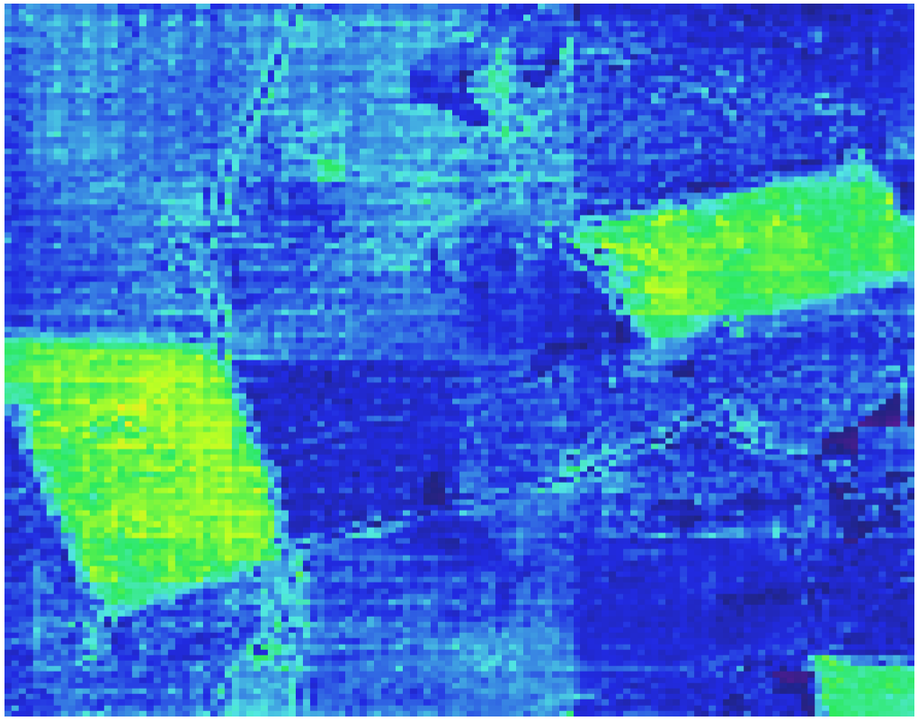
Site 22 MJJ21
Timestep 1
Timestep 5
Timestep 8
Timestep 15

Slide 10
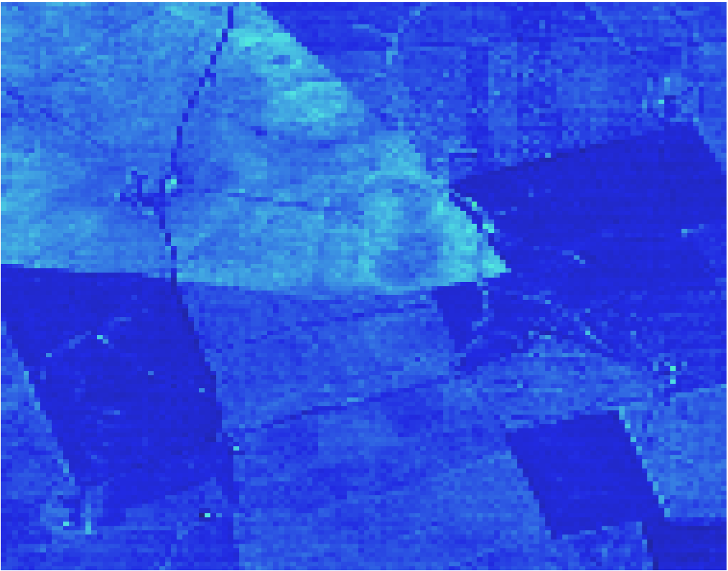
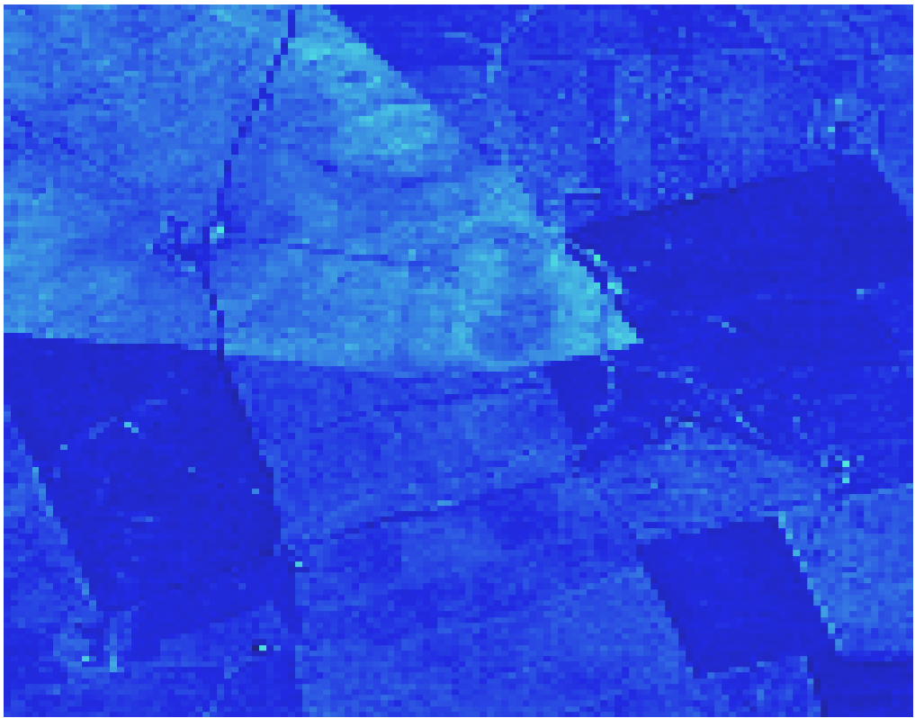
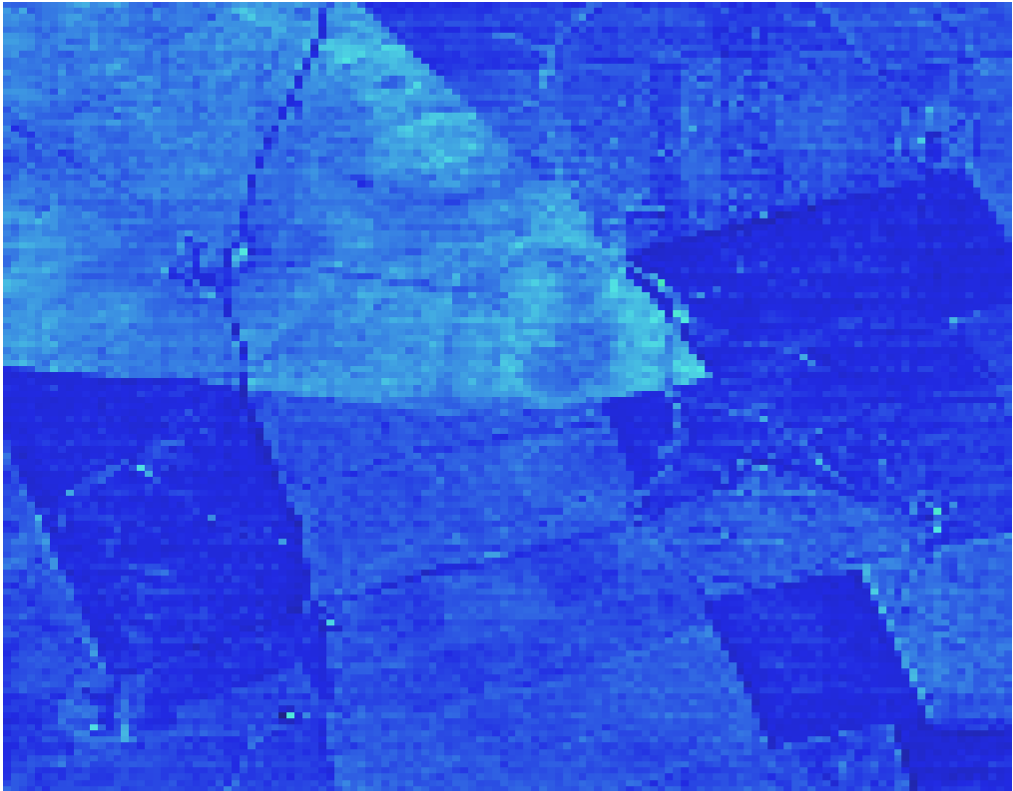
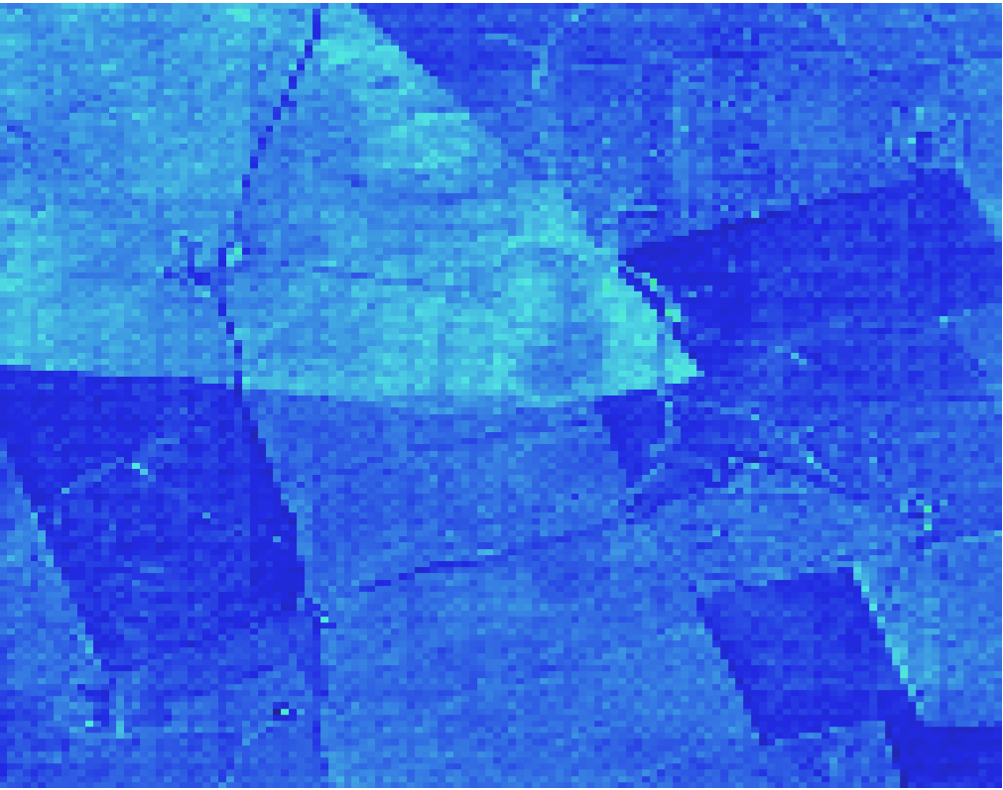
Site 22 JAS21
Timestep 5 (equivalent to MJJ21 Timestep 17)
Timestep 10
Timestep 15
Timestep 20

Slide 11
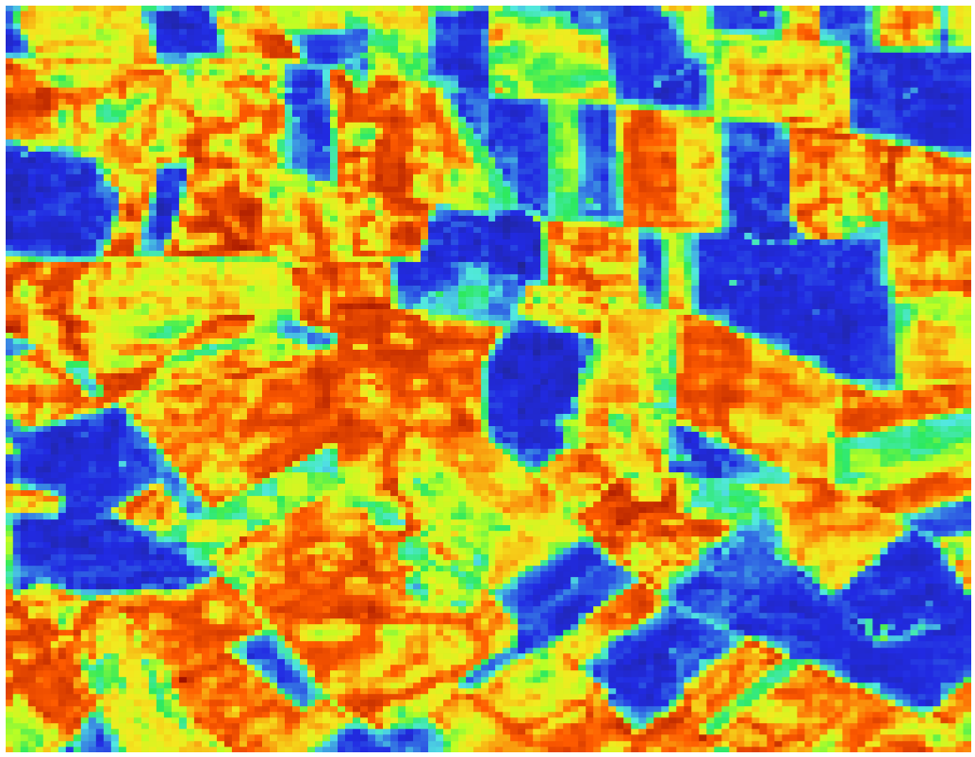
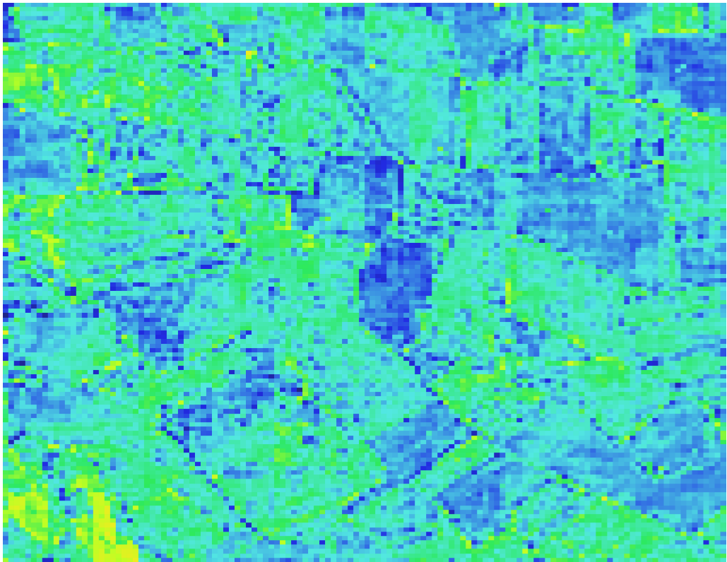
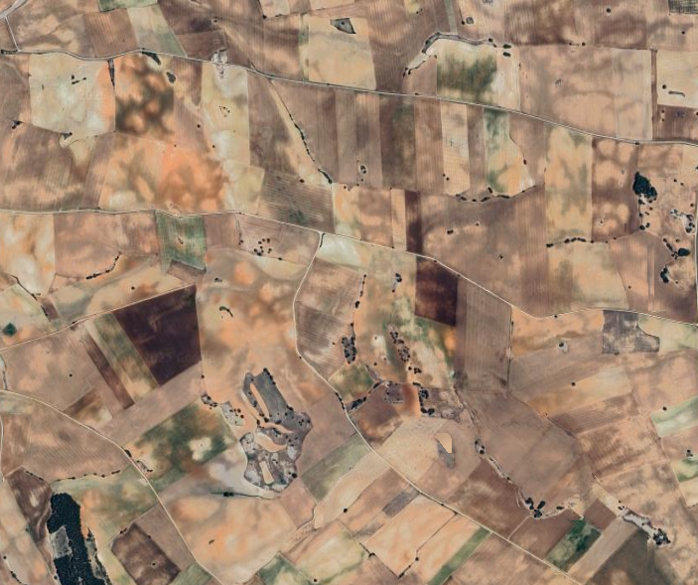
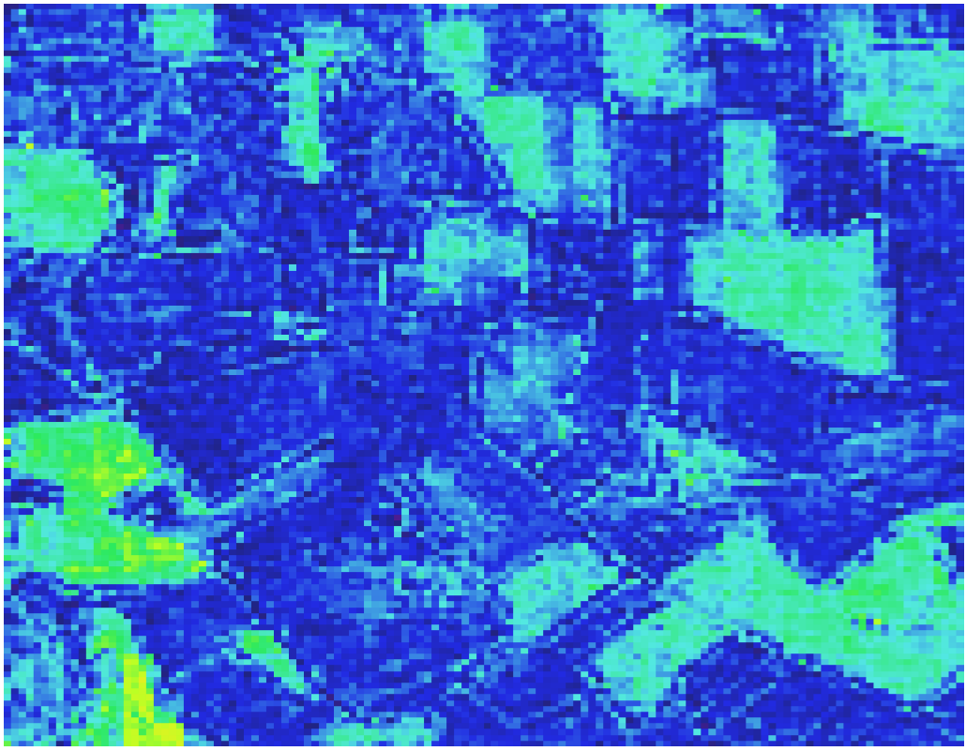
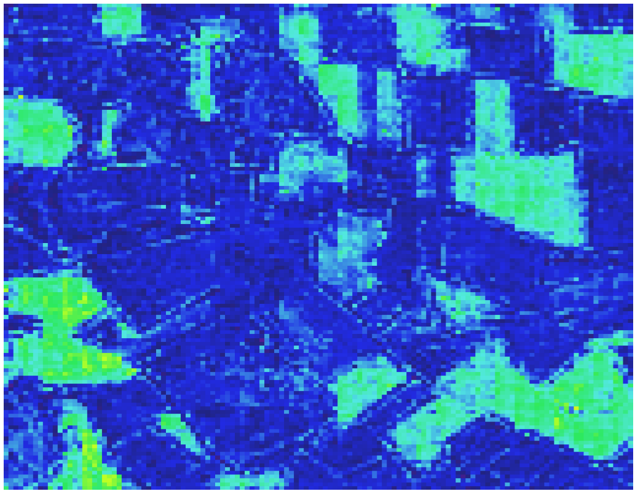
Site 27 MJJ21
Timestep 5
Timestep 10
Timestep 15
Timestep 20

Slide 12
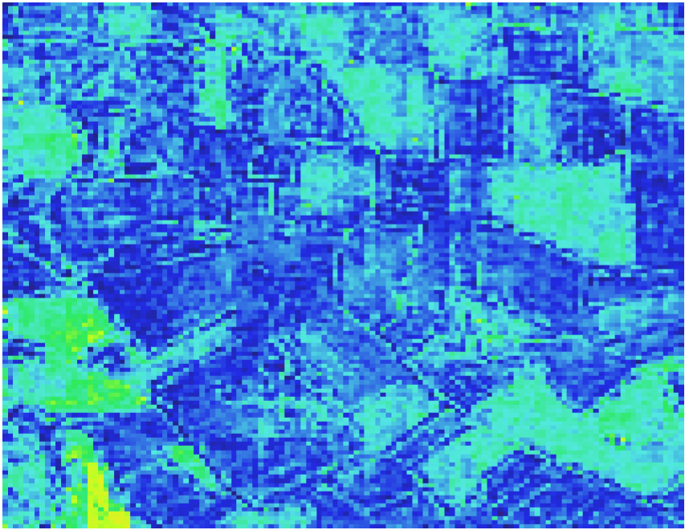
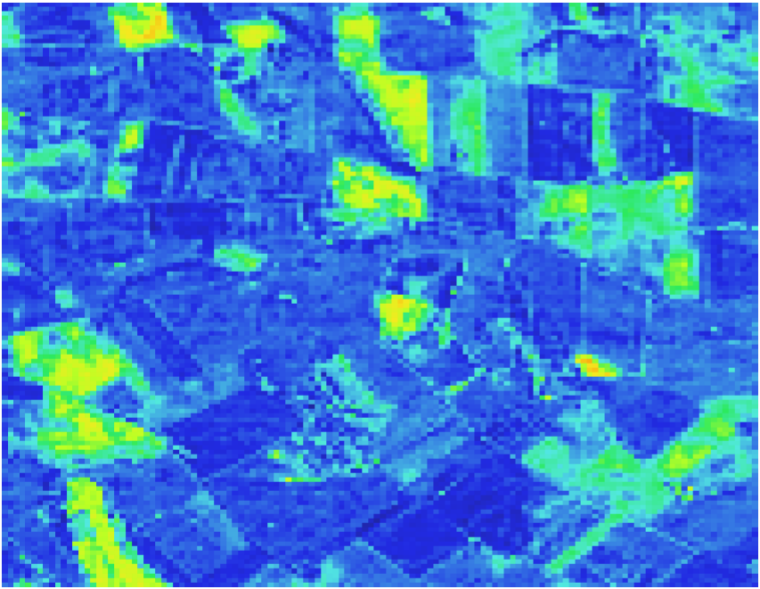
Site 27 Transition
MJJ21 Timestep 13 (equivalent to JAS21 Timestep 1)
MJJ21 Timestep 10
JAS21 Timestep 1

Slide 13
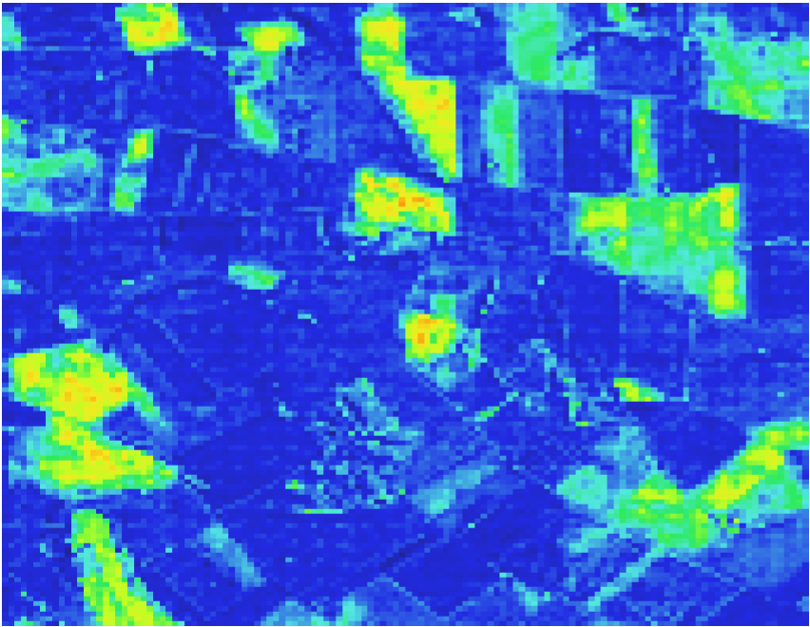
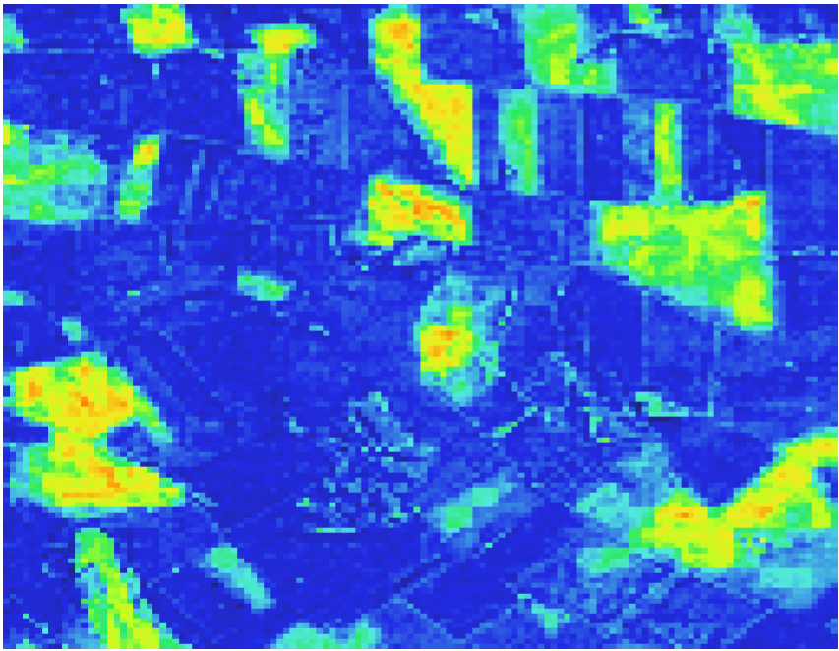
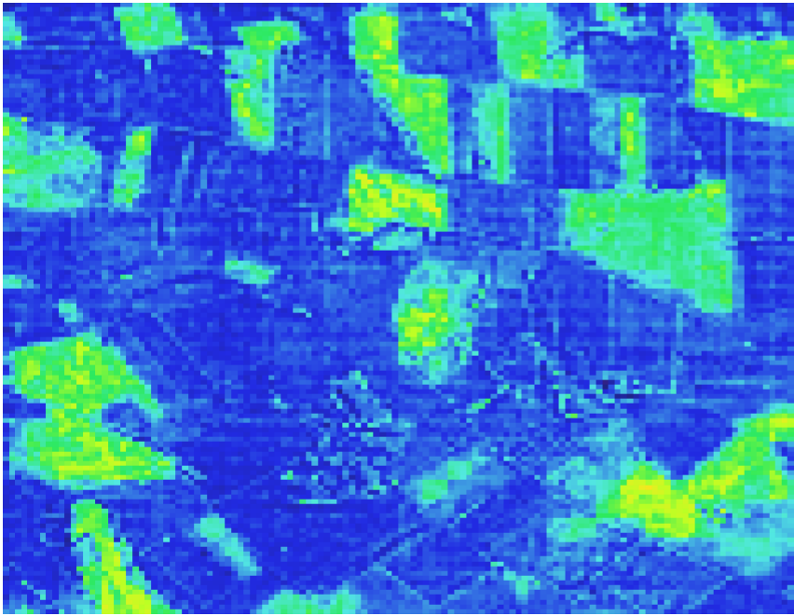
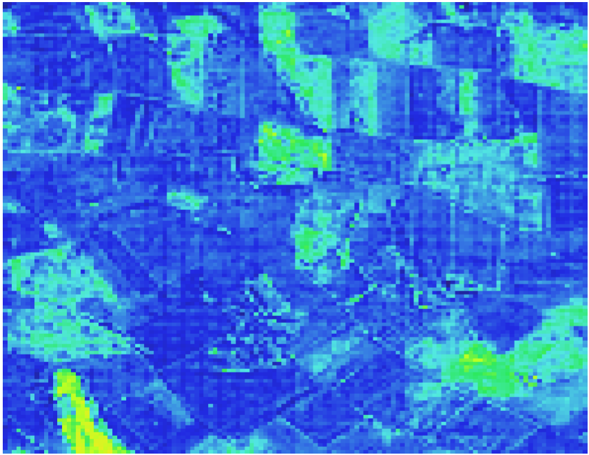
Site 27 JAS21
Timestep 3 (equivalent to MJJ21 Timestep 15)
Timestep 8
Timestep 13
Timestep 18

Slide 14
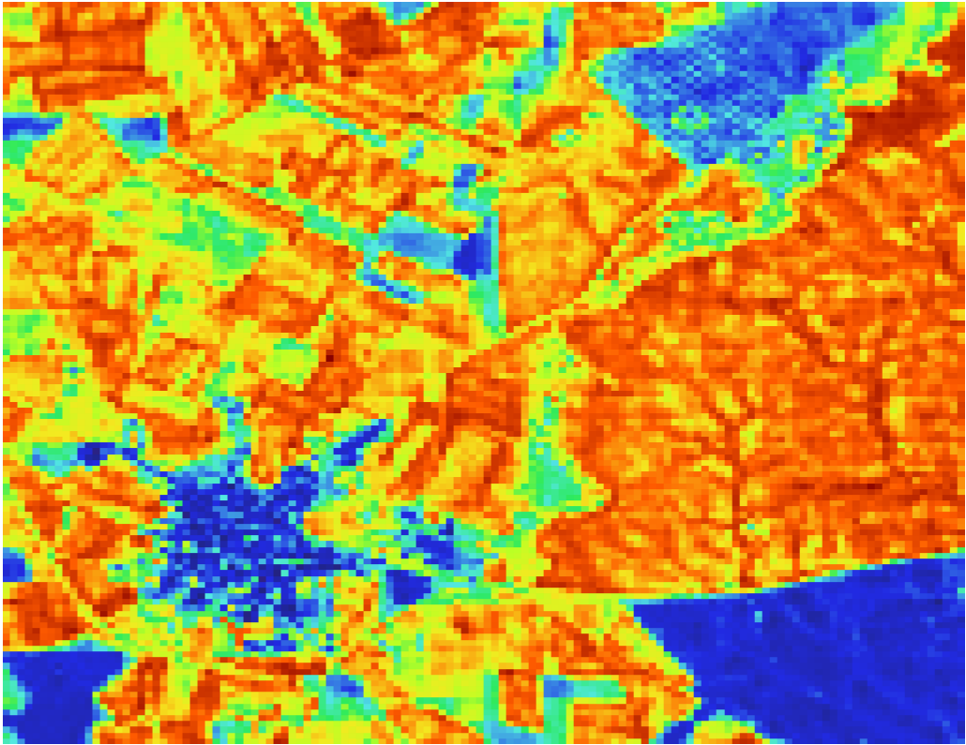
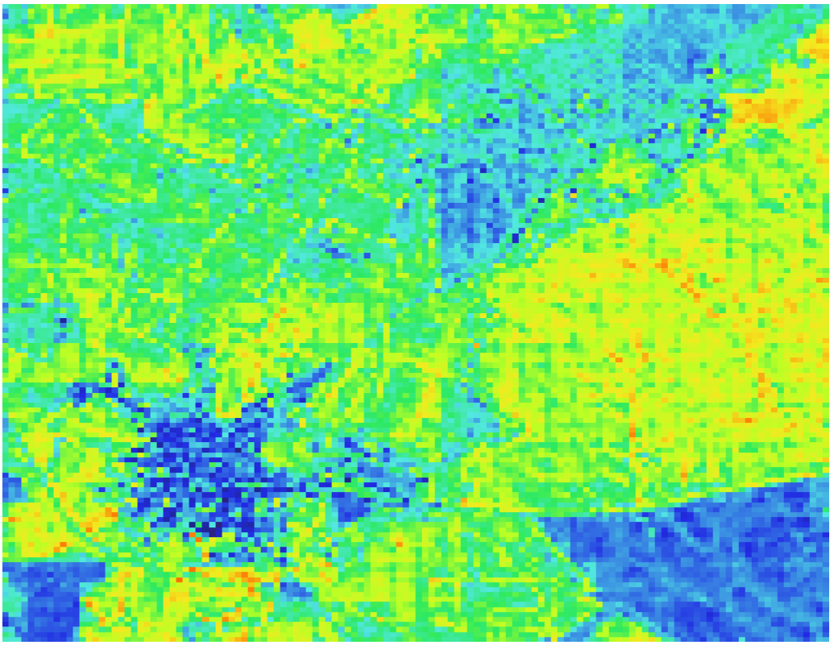
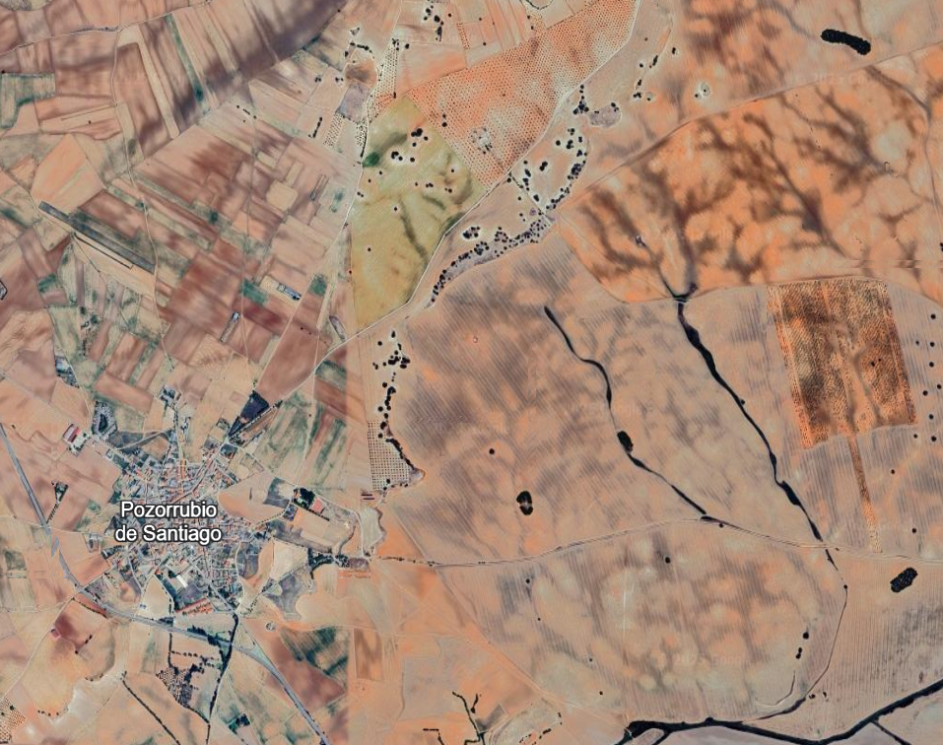
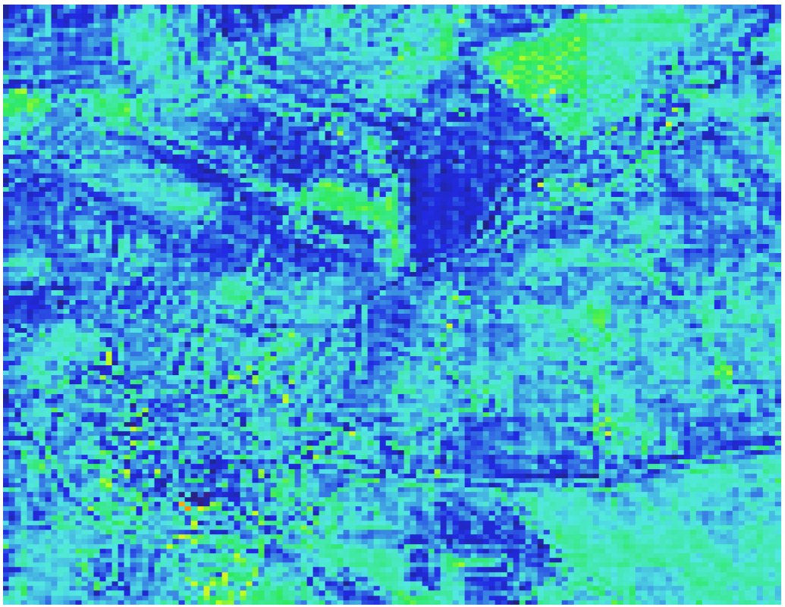
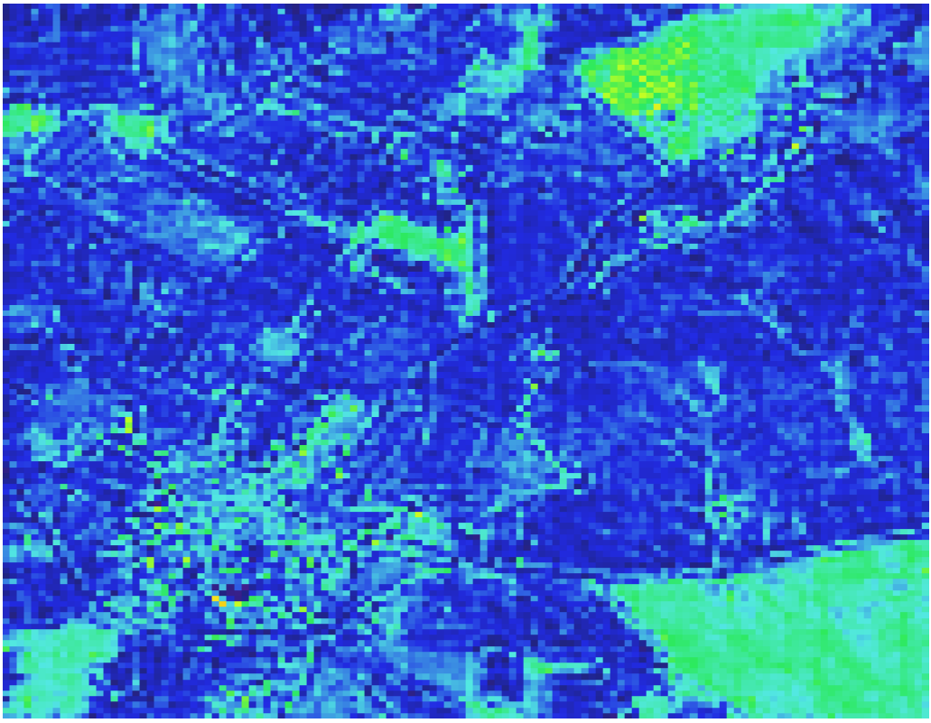
Site 28 MJJ21
Timestep 5
Timestep 10
Timestep 15
Timestep 20

Slide 15
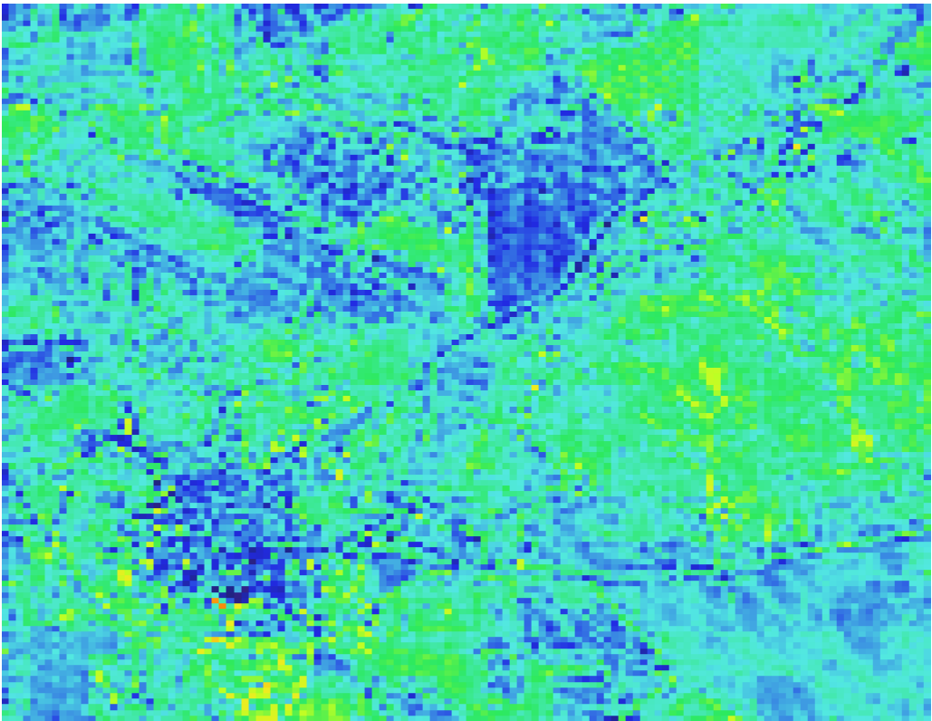

Site 28 Transition
MJJ21 Timestep 13 (equivalent to JAS21 Timestep 1)
MJJ21 Timestep 10
JAS21 Timestep 1

Slide 16




Site 28 JAS21
Timestep 3 (equivalent to MJJ21 Timestep 15)
Timestep 8
Timestep 13
Timestep 18

Slide 17





Site 36 MJJ21
Timestep 5
Timestep 10
Timestep 15
Timestep 20

Slide 18


Site 36 Transition
MJJ21 Timestep 13 (equivalent to JAS21 Timestep 1)
MJJ21 Timestep 10
JAS21 Timestep 1

Slide 19




Site 36 JAS21
Timestep 5
Timestep 10
Timestep 15
Timestep 20

Slide 20





Site 38 MJJ21
Timestep 5
Timestep 10
Timestep 15
Timestep 20

Slide 21


Site 38 Transition
MJJ21 Timestep 13 (equivalent to JAS21 Timestep 1)
MJJ21 Timestep 10
JAS21 Timestep 1

Slide 22




Site 38 JAS21
Timestep 5
Timestep 10
Timestep 15
Timestep 20

Slide 23





Site 57 MJJ21
Timestep 5
Timestep 10
Timestep 15
Timestep 20

Slide 24


Site 57 Transition
MJJ21 Timestep 13 (equivalent to JAS21 Timestep 1)
MJJ21 Timestep 10
JAS21 Timestep 1

Slide 25




Site 57 JAS21
Timestep 5
Timestep 10
Timestep 15
Timestep 20

Slide 26





Site 83 MJJ21
Timestep 5
Timestep 10
Timestep 14
Timestep 20

Slide 27

Site 83 Transition
MJJ21 Timestep 14 (equivalent to JAS21 Timestep 2)
JAS21 Timestep 2

Slide 28




Site 83 JAS21
Timestep 5
Timestep 10
Timestep 14
Timestep 20

Slide 29






Site 124 MJJ21
Timestep 5
Timestep 10
Timestep 15
Timestep 20
min/max temperature and precipitation data are missing from the minicube

Slide 30



Site 124 Transition
MJJ21 Timestep 13 (equivalent to JAS21 Timestep 1)
MJJ21 Timestep 10
JAS21 Timestep 1

Slide 31






Site 124 JAS21
Timestep 5
Timestep 10
Timestep 15
Timestep 20
min/max temperature and precipitation data are missing from the minicube

Slide 32





Site 170 MJJ21
Timestep 5
Timestep 10
Timestep 15
Timestep 20

Slide 33


Site 170 Transition
MJJ21 Timestep 13 (equivalent to JAS21 Timestep 1)
MJJ21 Timestep 10
JAS21 Timestep 1

Slide 34




Site 170 JAS21
Timestep 5
Timestep 10
Timestep 15
Timestep 20

Slide 35





Site 238 MJJ21
Timestep 5
Timestep 10
Timestep 15
Timestep 20

Slide 36


Site 238 Transition
MJJ21 Timestep 13 (equivalent to JAS21 Timestep 1)
MJJ21 Timestep 10
JAS21 Timestep 1

Slide 37




Site 238 JAS21
Timestep 5
Timestep 10
Timestep 15
Timestep 20

